Slide 1


Landslide Management Using Machine Learning UNEP Case
Hackstreet Boys
Nicolas Neudeck, Johannes Fuest, Thomas Böhm, Michael Fuest

Slide 2
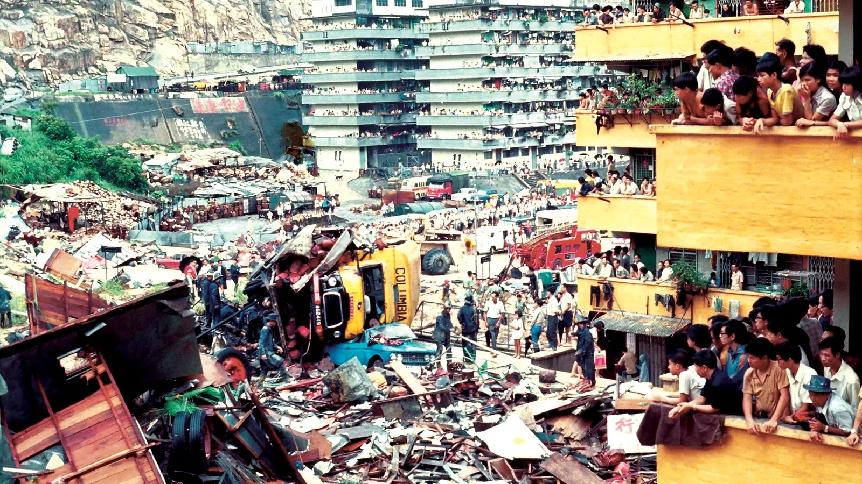

Slide 3
The Data
Feature engineering:
Featuretools & Boruta Package to auto-generate and select new features
Binning, discretization, windsorization to cap outliers
Features like grid elevation variance, mean absolute height difference of grid cells close to center, relative ortographic intensification factor added

Slide 4
The Model
Ensemble of Random Forests, Gradient Boost Models and Neural Networks:
Different sample rebalancing techniques used in each forest
Optimized hyperparameters with a grid search
Combined by averaging landslide probability provided by each tree
Probability thresholds for classification optimized

Slide 5
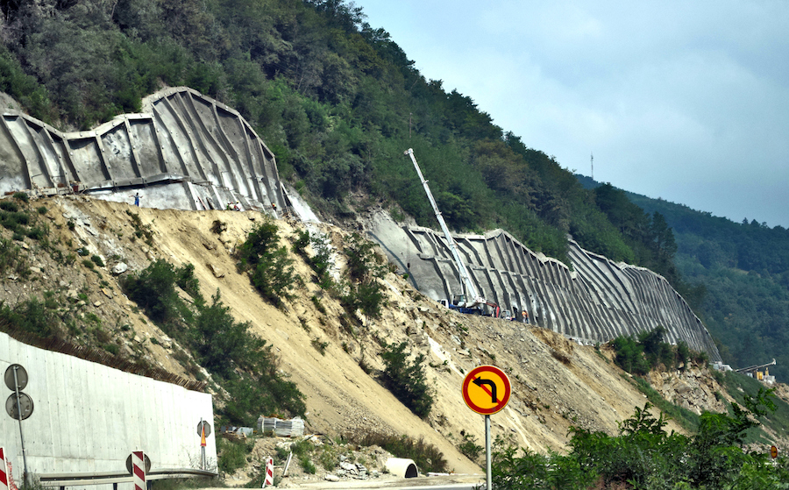
Phase 1: Pre-Landslide
Assignment of landslide risk factor from 1 - 5 for every grid in Hong Kong
Building permits, urban & landscape planning
Insurance incentives for residents in high-risk areas
Strategic placement of emergency response resources

Slide 6
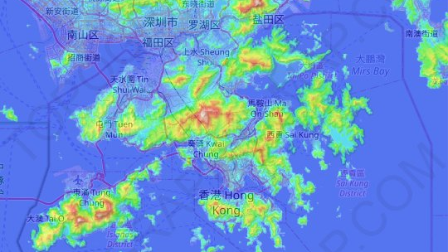

Slide 7

Phase 2: During Landslide
Use precipitation forecast to determine which risk areas to notify
Alert smartphone users via GPS using Gov HK Notifications system
Notification to emergency response teams

Slide 8
Phase 3: Post-Landslide
Rolling ingestion of new landslide data into model
Emergency response teams are on-site quickly
Casualties minimized due to evacuation of high-risk areas
Causal inference of misclassified landslide events in order to improve model
Enhanced insurance coverage from phase 1 to offset damage

Slide 9

Commercialization
Risk factor data interesting for insurance companies to conduct targeted advertising
Better information can be used to improve insurance pricing
Data can be sold to construction firms and property developers to improve risk management

Slide 10
Outlook
Meteorological and drone image data can be used to improve model performance
Automated drone footage collection combined with HK’s Enhanced Natural Terrain Landslide Inventory images
Applicable in other cities or to other natural hazards or geographies

